Slide 1
College Degree Levels
Part 2
College Prep
Mr. Gordon
jgordon@bisdtx.org

Slide 2
Upcoming Events
Weds. Sept. 25- BEST College Night @ BHS 7-8:30 PM
hi

Slide 3
College Degree Levels
College degrees are divided into four categories:
Associate Degree
Bachelor’s Degree
Master’s Degree
Doctoral Degree
You will hear these terms used often at CRCA when discussing College and Career.
hi

Slide 4
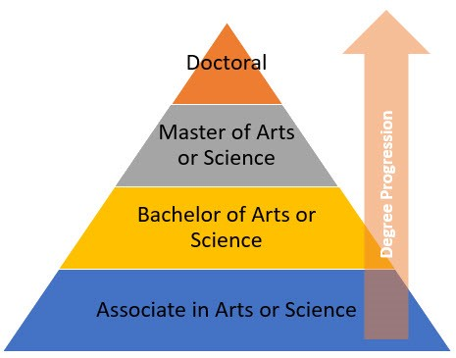
College Degree Levels
hi

Slide 5
Degree Overview
Only 13.1% of the US population has a Master’s or Doctorate degree.
Students who want to specialize in a certain field obtain their Master’s or Doctorate degree.
Some careers require a Master’s degree or higher,
such as College Professor, Doctor, and Lawyer.
Some careers require a Master’s if you want to supervise others or work at a higher level, such as education and engineering.
hi

Slide 6
Master’s Degree Overview
Must have already graduated with a Bachelor’s degree
Usually takes 2-3 years to complete
Must complete 30-36 credit hours
Can be completed at most universities
hi

Slide 7
Doctoral Degree Overview
This is the highest level of formal education
Must have a Bachelor’s and a Master’s degree
Can take 2-10 years
Requirements and hours vary greatly depending on field of study and university
hi

Slide 8
Why would I do that?
Even though it takes a few years.
There are some reasons to obtain a higher level of education:
To move up in your career
To make more money
To maintain your job
hi

Slide 9
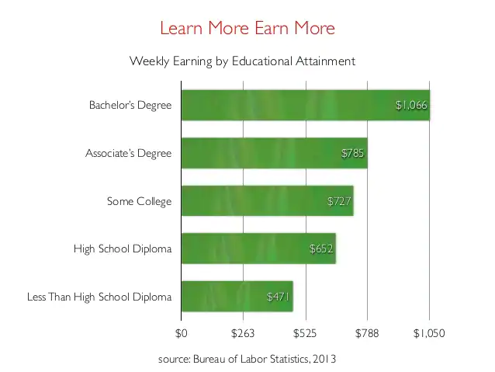
College Degree Levels
A person with a Bachelor’s degree on average earns $339 more a week than a person with just a high school diploma.
That is $17,628 a year and over half a million over 30 years of work.
hi

Slide 10
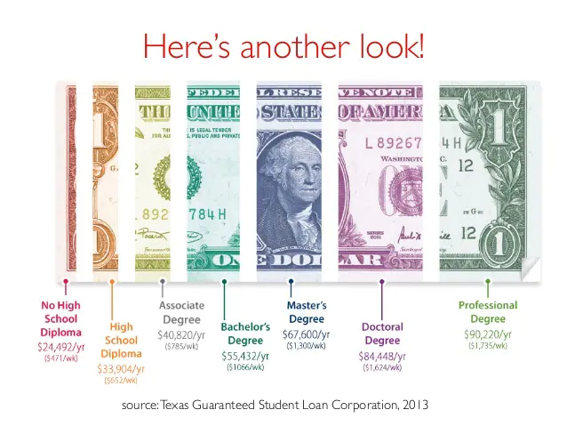
College Degree Levels
This is a look at the average yearly wage for a person with each education level.
hi

Slide 11
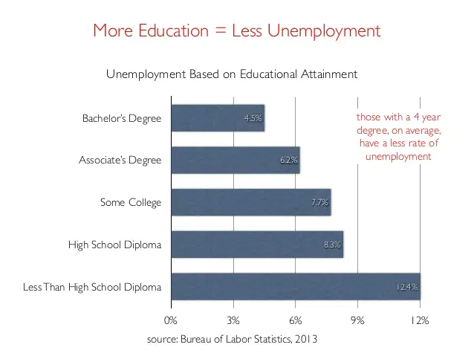
College Degree Levels
The more education you obtain the more likely you are to have a job.
The unemployment rate for a person with a Bachelor's degree is 3.7% compared to just a high school degree at 6.7%.
hi

Slide 12
Today’s College Prep Assignment
In the comments section of today’s College Prep,
answer the following question:
Using one of the majors you chose earlier, what degree does your future career require?
hi

